Slide 1
Government Allowances
The Age Pensions

Slide 2
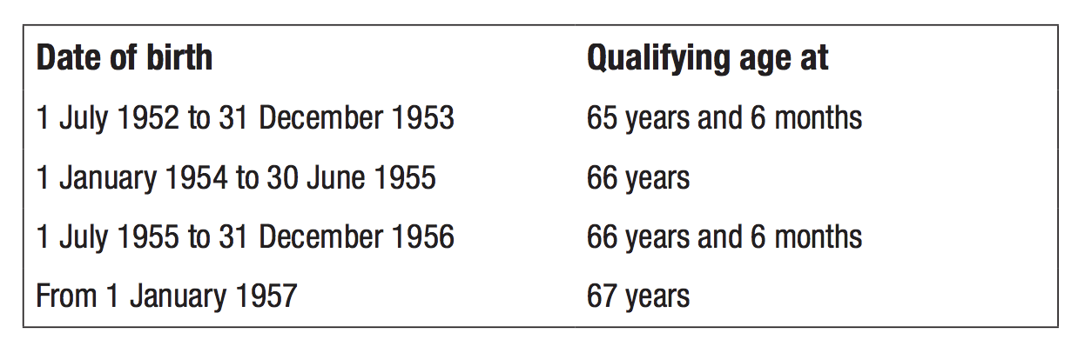
The Age Pension
https://www.humanservices.gov.au/sites/default/files/2017/06/ci006-1707en-p.pdf

Slide 3
Payment Rate (fortnightly)
$582.40
Note: There are new rates from Department of Human Services website.

Slide 4
Adjustment/reduction based on either:
Full Pension
Assets Test
Pension
Income Test
The lesser of the two amounts will be the pension

Slide 5
What are assets?
Notes:
https://www.budgetdirect.com.au/blog/how-australian-housing-has-changed-over-the-years.html
https://au.pinterest.com/pin/520025088193023365/
http://www.sharemarketschool.com/stocks-explained/
https://www.cartrade.com/new-cars/by-price/5lakh-10lakh

Slide 6

Assets Test
Full fortnightly pension will be reduced by
$1.50 for single
$0.75 for each member of a couple
for each $1000 above the amount showed in the table
Full Pension
Assets Test
Pension

Slide 7
Full pension will be reduced by $1.50 for each $1000 above the limits
Full pension will be reduced by $0.75 for each $1000 above the limits
$412,500
$332,000
$273,000
$192,500

Slide 8
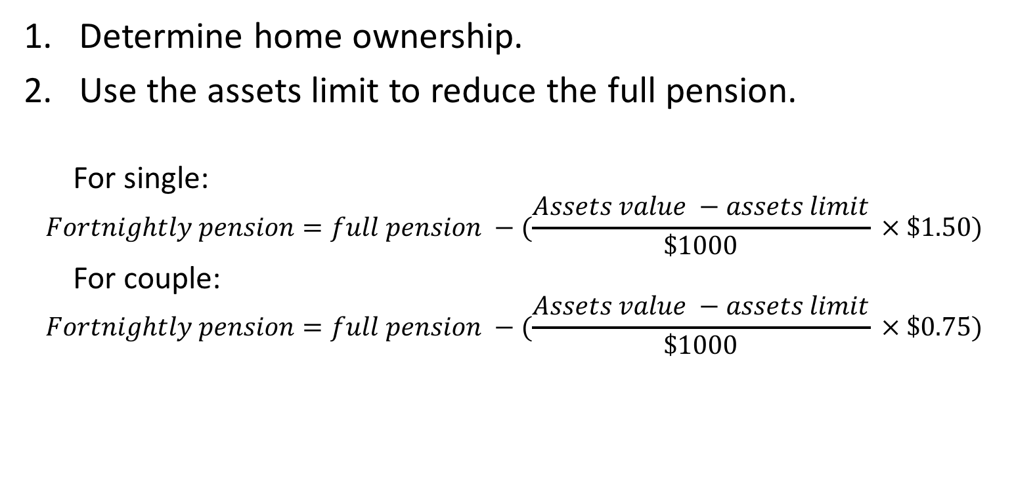
Assets Test
Determine home ownership.
Use the assets limit to reduce the full pension.
For single:
$$Fortnightly pension=full pension −(\frac{Assets value −assets limit}{\$1000} × \$1.50)$$
For couple:
$$Fortnightly pension=full pension −(\frac{Assets value −assets limit}{\$1000} × \$0.75)$$

Slide 9
INCOME ????
Notes:
https://stuartsfin.wordpress.com/2012/10/30/make-sustainability-a-priority-when-planning-your-retirement-income/

Slide 10

Income Test
Full fortnightly pension will be reduced by
$0.50 for single
$0.25 for each member of a couple
for each $1 above the amount showed in the table
Full Pension
Pension
Income Test

Slide 11
INCOME
Income earning assets
Bank accounts
Shares
Investment properties
Other investments
These will be deemed to earn income at the “deeming rate”, using 4% in this case.
Employment
Part-time
Casual
Etc.
Frist $250 earned not included in the income test [work bonus]
Fortnightly income = (Employment income - $250) + (Assets Income)
EACH

Slide 12
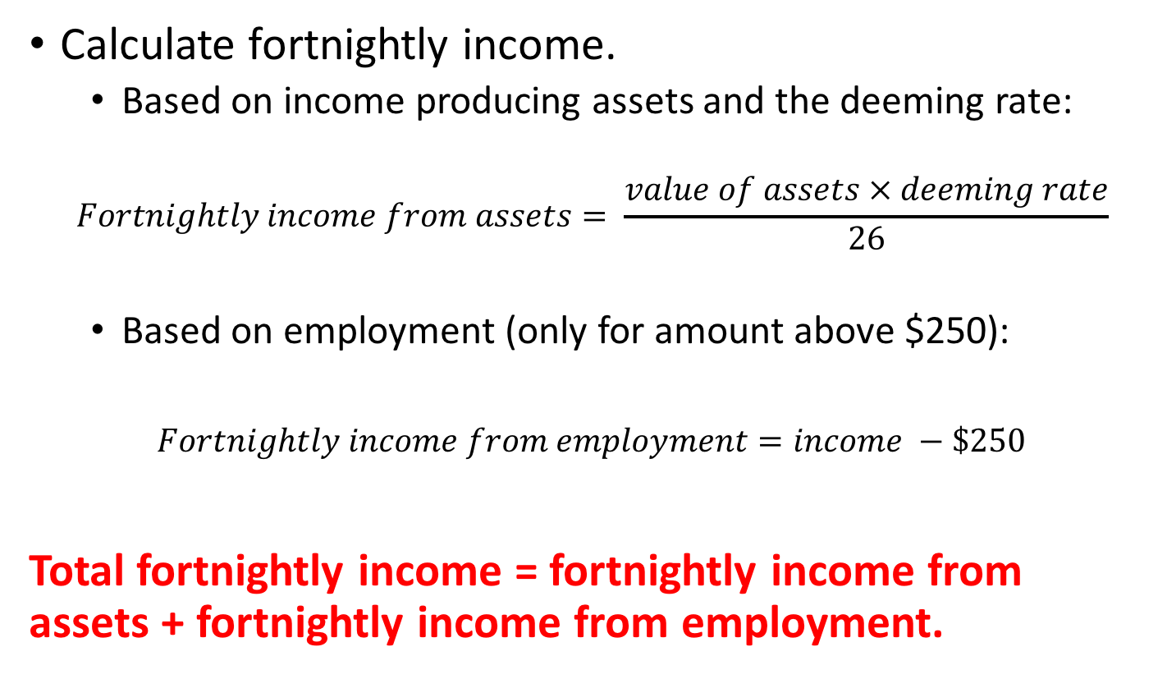
Income Test
Calculate fortnightly income.
Based on income producing assets and the deeming rate:
$$Fortnightly income from assets= \frac{value of assets × deeming rate}{26}$$
Based on employment (only for amount above $250):
$$Fortnightly income from employment=income −\$250$$
Total fortnightly income = fortnightly income from assets + fortnightly income from employment.

Slide 13
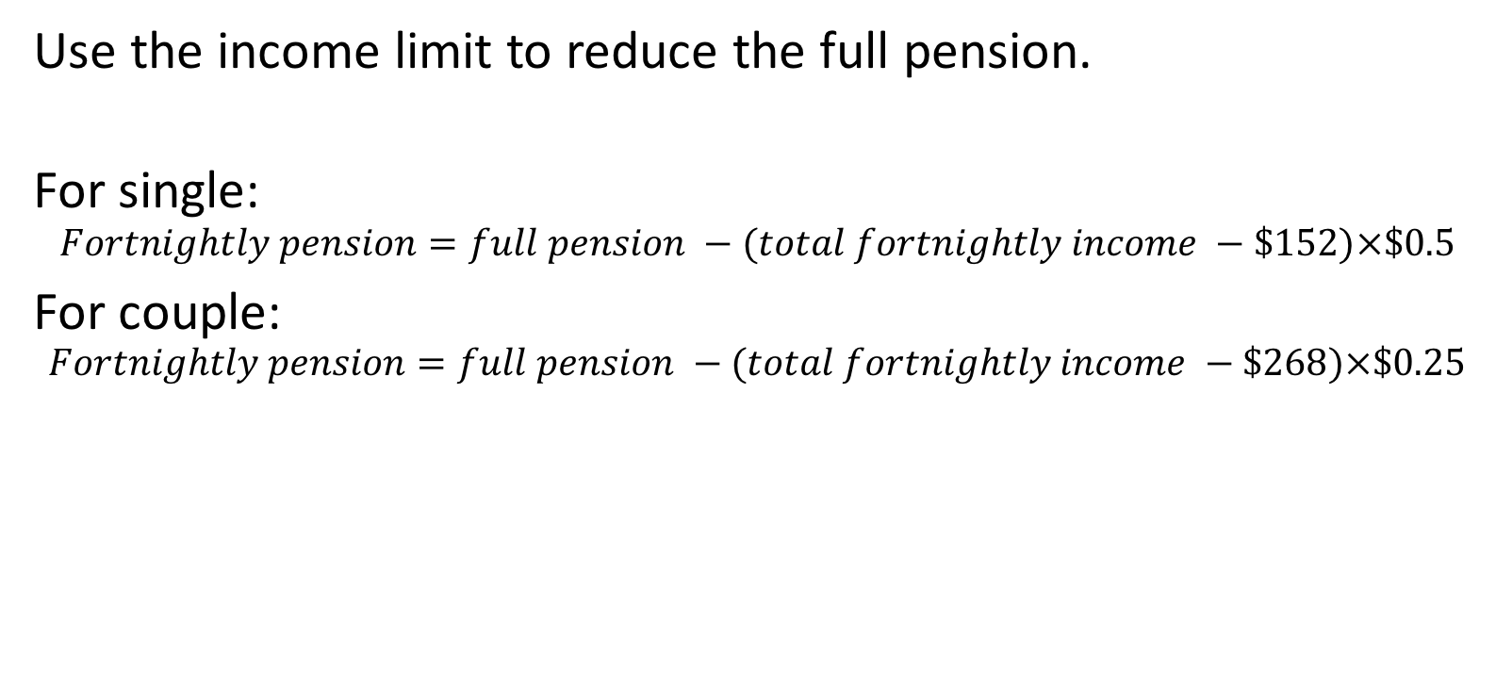
Income Test (cont’d)
Use the income limit to reduce the full pension.
For single:
$$Fortnightly pension=full pension −(total fortnightly income −\$152)×\$0.5$$
For couple:
$$Fortnightly pension=full pension −(total fortnightly income −\$268)×\$0.25$$

Slide 14
Example 1 - Single
Margaret, a retiree, owns the house she lives in which is worth $350,000. She has assets which are worth $500,000, of which $320,000 is deemed to earn 4% per annum income. She also earns a fortnightly income of $150 from tutoring. Determine her fortnightly age pension.

Slide 15
Example 2 - Single
John rents a house after retirement. He has assets which are worth $150,000, of which $80,000 is deemed to earn 4% per annum income. Determine his fortnightly age pension.

Slide 16
Example 3 - Couple
Mr. and Mrs. White live in a flat they owned which is worth $200,000. They have assets which are worth $425,000, of which $298,000 is deemed to earn 4% per annum income. To supplement their income, they make $100 each per week cleaning at a local aged care facility. Determine Mrs. White’s fortnightly age pension.

Slide 17
Example 4 - Couple
Mr. & Mrs. Brown live in a caravan park. They have assets which are worth $285,000, of which $200,000 is deemed to earn 4% per annum income. Mr. Brown earns $400 a fortnight as the caretaker of the caravan park while Mrs. Brown earns $200 a fortnight tutoring mathematics. Determine their combined fortnightly age pension.

Slide 18
Summary
Determine the status – single or couple.
This will determine the full pension.
Apply Assets Test to determine the value of the fortnightly pensions.
For Income Test, determine the fortnightly income – combine the income from assets and from employment.
Apply Income test to determine the value of fortnightly pensions.
The lesser of the two amounts will be the fortnightly pension (round to the nearest dollar)

